Slide 1
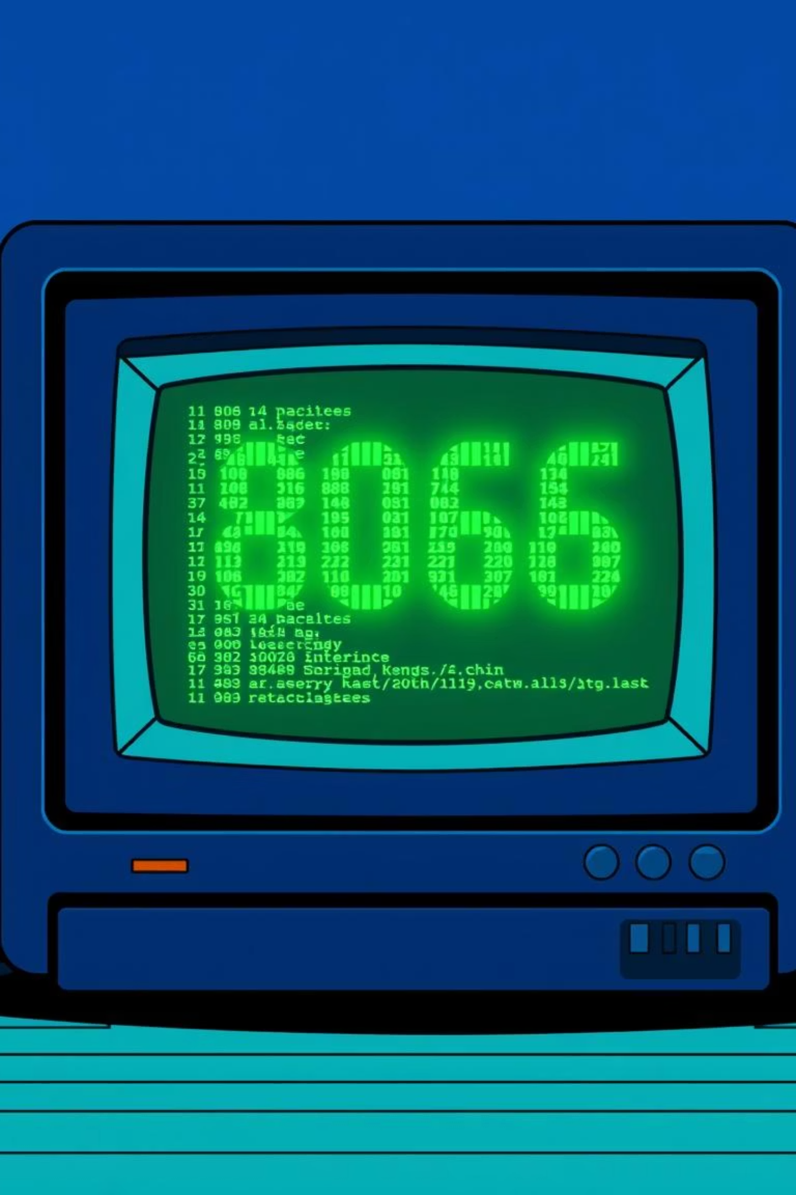
Compact Assembly Toolkit
A Multimodel Assembly Demonstration
Computer Organization and Assembly Language
Team members :-
Muhammad Ahmed (2412115)
Muhammad Huzaifa (2412118)
Sandeep Kumar (2412124)

Slide 2








Project Objectives
To reinforce fundamental computer architecture concepts and simulate basic operating system behavior in a 16-bit environment.
Registers
Memory Segmentation
Understanding their role in instruction execution.
Direct memory manipulation for graphics and data.
OS Behavior
Instruction Execution
Implementing basic functions without an OS.
Simulating core system tasks like arithmetic and I/O.

Slide 3



What problem are we solving ?
Demonstrted Concepts
Problem Addressed :-
Modern programming environments abstract hardware details, making it difficult for students to understand how software actually interacts with CPU, memory, and I/O devices.
Core concepts like keyboard input handling, graphics rendering, and arithmetic computation are often taught
theoretically without showing real hardware-level execution.
Our Solution :-
This project provides a hands-on 8086 assembly toolkit that demonstrates how core system functions are implemented at the lowest level.
BIOS interrupts are used to capture raw keyboard input (INT 16h), perform low-level input/output (INT 21h), and control graphics (INT 10h).
Direct memory access and VGA Mode 13h demonstrate pixel-level graphics rendering without any high-level abstraction.
The calculator module exposes how high-level arithmetic operations are built from basic CPU
instructions, registers, and control flow.

Slide 4
Project Overview
This project introduces a comprehensive toolkit designed to explore the fundamentals of assembly language and computer organization through practical demonstrations.
Demonstrated Concepts
Importance for Learning
Toolkit Scope
The toolkit offers a hands-on application of assembly language.
It demonstrates how various architectural models execute instructions.
It shows interactions with system resources.
Features basic I/O operations.
Understanding the toolkit enhances comprehension of computer architecture.
It reveals intricate processes underlying high-level programming.
Crucial for grasping low-level programming concepts.
Important for understanding direct hardware interaction.
Helps in learning foundational principles of software-hardware interfaces.
The toolkit supports various assembly models.
It offers a versatile platform for experimentation.
Provides hands-on experience in writing assembly code.
Includes debugging assembly code.
Covers optimizing assembly code.

Slide 5





Tools & Technologies
Developed using EMU8086 for a simulated 16-bit DOS real-mode environment.
EMU8086
BIOS Interrupts
x86 emulator and IDE for assembly.
INT 10h (graphics) & INT 16h (keyboard).
DOS Interrupts
VGA Mode 13h
INT 21h for input/output operations.
320x200, 256-color graphical mode.

Slide 6



Bridging High-Level Concepts with Low-Level Execution
This project provides hands-on experience with low-level system programming, demonstrating how high-level features are built from basic CPU instructions.
Hardware Interaction
Memory Management
System Programming
Direct manipulation of hardware via BIOS interrupts.
Manual data conversion and memory handling.
Understanding core system features from basic instructions.

Slide 7




Methodology: Modular Approach
Our toolkit is divided into three core modules, each demonstrating a key aspect of low-level system interaction.
Smart Calculator
Keyboard Input Demo
Basic arithmetic and constant lookup.
Raw input capture and processing.
Graphic Effects Renderer
Direct pixel manipulation for visuals.

Slide 8

Smart Calculator: Core Backend Functionality
Performs basic calculations and displays constant values, simulating essential backend processes.
Operations
Constants
Addition (+)
Pi Constant
Subtraction (-)
Euler's Theorem
Multiplication (x)
Golden Ratio
Division (/)
Speed of Light
Power (^)
Feigenbaum's Constant
Modulus (%)
Euler-Mascheroni Constant
Pythagoras Theorem
Fine-Structure Constant

Slide 9

Keyboard Input Demonstration
Showcases how the computer system receives and processes keyboard input at a low level using BIOS interrupt 16h.
Raw Input Capture
Input Classification
Retrieves ASCII and scan codes directly.
Identifies alphabetic, numeric, and special characters.
History Tracking
Stores and displays the last and previous key presses.

Slide 10
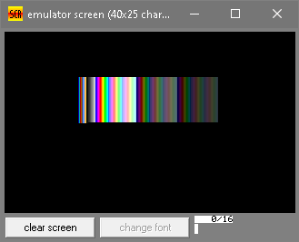
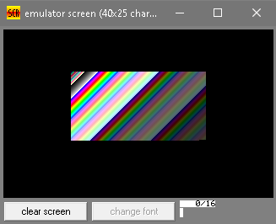
Graphic Effects Renderer
Demonstrates direct pixel access in VGA mode 13h to create appealing visuals, enhancing user interaction.
Horizontal Gradient
Plasma Effects
Controlled color interpolation across the screen.
Generates organic patterns using simple arithmetic.
VGA mode 13h provides a linear frame buffer for direct pixel access, simplifying rendering logic.

Slide 11
Limitations
Environment and Compatibility
Functional Limitations
Graphics Limitations
Performance and Usability
Operates only in EMU8086 emulator, limiting compatibility to legacy x86 architectures.
No integration with modern 64-bit systems or varied hardware.
Relies on BIOS and DOS interrupts, restricting to basic operations.
Lacks support for multitasking, advanced floating-point arithmetic, or secure input.
Graphical rendering limited to low-resolution VGA Mode 13h.
Does not support modern graphics APIs or scalable displays.
Performance issues due to emulator's interpreted execution.
Absence of robust error handling and debugging tools.

Slide 12
Future Improvements
Expanding functionality and modernizing the toolkit for enhanced educational value.
Advanced Calculator
Floating-point, trigonometry, expression parsing.
Interactive Keyboard
Full key mappings, modifier states, macros.
Modern Graphics
Fractals, particle systems, higher resolutions.
Cross-Platform Migration
C, C++, or Python for broader compatibility.

